Slide 1
LAN GAME(CHESS)
Team members
S.Senthilmurugan
R.Anuradha
V.Aishwarya
Guide Name : Dr.P.Ilanchezian

Slide 2
ABSTRACT
The aim of our project is to provide both a chess as well as chat facility in one application such that two users can play the chess as well as chat each other on the network that is any number of computers connected via a network. Generally, the chess game is played against the human user and the computer on which the user is operating, so the need is to make the chess game being played against two human users on the two different machines on the network, no matter their physical location and as well as allowing chat among those two users. The main objective of our project is to provide a user-friendly interactive environment to the users of the application that helps them to play and communicate with a lot of ease and to help the users in playing the chess by explaining the moves of each pieces , if they require. Since there exists client and server as the project is based on client server architecture, where server is serving as a mediator in between the players and the client is making request to server as well as doing all the part that is related to playing logic.

Slide 3
HARDWARE REQUIREMENTS
PROCESSOR :2GHz
RAM :2GB OF RAM(MINIMUM)
HARDDISK :4GB

Slide 4
SOFTWARE REQUIREMENTS
Operating System :Windows7 and Above
IDE :Pycharm

Slide 5
COMPONENTS USED
Pygame
Socket
Pickle

Slide 6
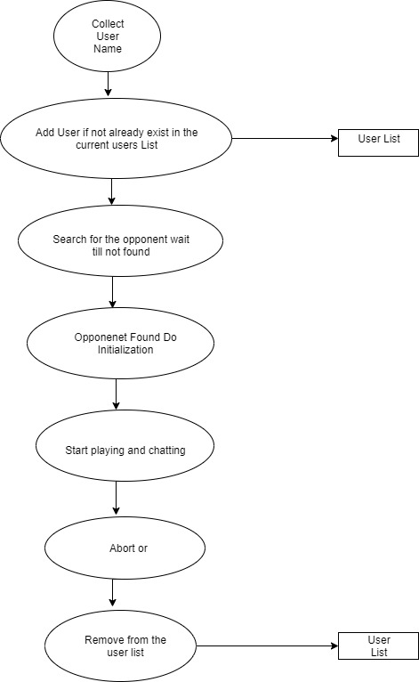
DATA FLOW DIAGRAM

Slide 7
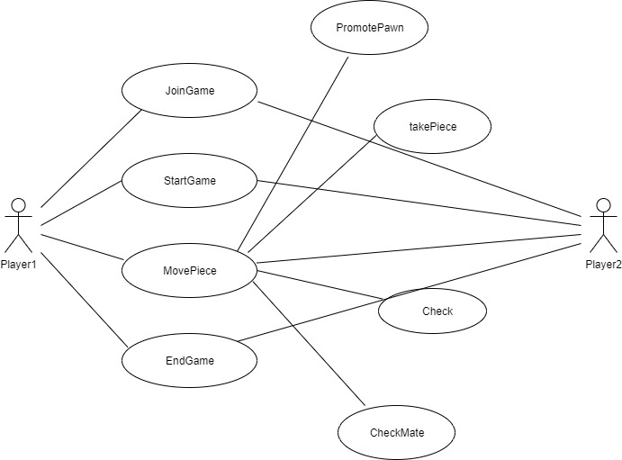
USECASE DIAGRAM

Slide 8


